Slide 1
Data Focused Python
95888
Carnegie Mellon University
Week 2: More Collections, Type
Conversion, and Web Scraping

Slide 2
Collection Built-In Types
Python 3.8 provides
list # "like" an array
tuple # "like" a record
set # just one of each value
frozenset # (we won't care)
A str can also be used as a collection

Slide 3
tuple Examples
A tuple is enclosed in (...)
  Items are indexed from 0 to n-1
    Use [idx] to access an item (like with lists)
  Or in reverse from -1 to -n
>>> n = ('a', 'golden', 'eagle', 'soars')
>>> type(n)
<class 'tuple'>
>>> n
('a', 'golden', 'eagle', 'soars')
>>> n[2]
'eagle'

Slide 4
tuple Examples (cont)
A tuple is immutable
  tuple items cannot be modified
  But a variable can be changed to refer to a different tuple (i.e. you can override the original variable)
>>> n
('a', 'golden', 'eagle', 'soars')
>>> n[1] = 'bald'
... TypeError ...
>>> n = (n[0], 'bald', n[2], n[3])
# a new tuple is created here and then assigned to n
>>> n
('a', 'bald', 'eagle', 'soars')

Slide 5
tuple Examples (cont)
You can assign tuple items to separate variables
  Called sequence unpacking
>>> a, b, c, d = n # where n = ('a', 'bald', 'eagle', 'soars')
>>> c
'eagle'
You can construct a tuple without parentheses
  Called tuple packing
>>> t = 1, 4, 'hi', 4.6 # same as t = (1, 4, 'hi', 4.6)
>>> t
(1, 4, 'hi', 4.6)

Slide 6
Multiple Assignment
Multiple assignment combines tuple packing and sequence unpacking
  This is just a shorthand way to assign values to variables
>>> a, b, c, d = 'hi', 12.6, True, 9
To swap the values of two variables:
>>> a = -7
>>> b = 3
>>> b, a = a, b # swap values around
>>> print(a, b)
3 -7

Slide 7
Empty and One-Item tuples
An empty tuple can be represented as ()
>>> t = ()
>>> type(t)
<class 'tuple'>
>>> t
()

Slide 8
Empty and One-Item tuples (cont)
But parentheses are also used for grouping in, for e.g., mathematical equations
  So, (value) is simply value
>>> t = (6) # t is not a tuple here, just a value
>>> t
6
The goofy (value,) creates a one-item tuple
>>> t = (6,) # t is now a tuple
>>> t
(6,)
>>> len(t)
1

Slide 9
tuple Slices and Concatenation
Like a list or str, a tuple is a sequence, supporting slices
  Another way to construct a tuple from an existing tuple:
>>> n
('a', 'bald', 'eagle', 'soars')
>>> n = n[:1] + ('harpy',) + n[2:]
# concatenation of tuples works like with str sequences
# i.e. it appends
>>> n
('a', 'harpy', 'eagle', 'soars')

Slide 10
set Examples
A set is enclosed in {...}
  Items are unsorted (although may appear sorted when displayed), with no duplicates
    Equivalent to sets in mathematics: an unordered collections of unique elements
    Basic uses include membership testing and eliminating duplicate entries.
>>> s = { 1, 6, 5, 9, 2, 1, 6, 3 }
>>> type(s)
<class 'set'>
>>> s
{1, 2, 3, 5, 6, 9}

Slide 11
set Named Operations
set provides many named operations for manipulating items, including
add(val) # add val to set
discard(val) # remove val from set, if
# val is a member
remove(val) # remove val, and fail if
# val is not a member
pop() # remove and return an
# arbitrary item
clear() # remove all items
val in s # val is in s, True/False
https://docs.python.org/3/tutorial/datastructures.html#sets

Slide 12
set Examples (cont)
>>> s
{1, 2, 3, 5, 6, 9}
>>> s.add(7)
>>> s
{1, 2, 3, 5, 6, 7, 9}
>>> s.add(3) # not an error
>>> s
{1, 2, 3, 5, 6, 7, 9}
>>> s.discard(2)
>>> s
{1, 3, 5, 6, 7, 9}

Slide 13
set Examples (cont)
>>> s.discard(2) # try again, no error
>>> s
{1, 3, 5, 6, 7, 9}
# s remains unchanged
>>> s.remove(2)
# fails and returns an error!
>>> s
{1, 3, 5, 6, 7, 9}

Slide 14
set Examples (cont)
>>> s
{1, 3, 5, 6, 7, 9}
>>> s.pop()
1 # maybe; maybe something else
>>> s
{3, 5, 6, 7, 9}
>>> 9 in s
True
>>> 8 in s
False
>>>

Slide 15
set vs. set Operations
set provides "the usual suspects" of set vs. set operations (methods)
s1.difference(s2) # s1 - s2
s1.symmetric_difference(s2)
# (s1 – s2)∪(s2 – s1) i.e. diff of 2 sets
s1.intersection(s2) # s1 ∩ s2
s1.isdisjoint(s2) # True or False
s1.issubset(s2) # s1⊆s2, True or False
s1.issuperset(s2) # s1⊇s2, True or False
s1.union(s2) # s1 ∪ s2

Slide 16
set Examples (cont)
>>> s
{3, 5, 6, 7, 9}
>>> s2 = {3, 4, 8, 9, 10}
>>> s.union(s2) # notice no duplicates in result
{3, 4, 5, 6, 7, 8, 9, 10}
>>> s.difference(s2)
{5, 6, 7}
>>> s.difference(s2).issubset(s)
# do difference first and then check if result is a subset
True
>>> s.intersection(s2)
{9, 3}

Slide 17
set Symbolic Operations
set provides some symbolic (borrowed from C/C++) operations
These can be used instead of the named operations.
  - same as set difference
  & "and" (same as intersection)
  ^ "xor" (same as symmetric_difference, i.e. diff of 2 sets)
  | "or" (same as union)
  (The order of precedence above is from highest to lowest)
Notes:
symmetric_difference – difference of two sets

Slide 18
set Examples (cont)
>>> s
{3, 5, 6, 7, 9}
>>> s2
{3, 4, 8, 9, 10}
>>> s & s2 # intersection: s.intersection(s2)
{9, 3}
>>> s | s2 # union: s.union(s2)
{3, 4, 5, 6, 7, 8, 9, 10}
>>> s ^ s2 # symmetric_difference
{4, 5, 6, 7, 8, 10}
>>> s | s2 == (s ^ s2) | (s & s2)
# same as: (s | s2) == ((s ^ s2) | (s & s2))
# order of operations! But best to use parentheses for ease-of-readability
True

Slide 19
set Examples
Elements of sets do not need to be of the same type
>>> s
{1, 2, 3, 5, 6, 9}
>>> s.add('hello')
>>> s
{1, 2, 3, 5, 6, 9, 'hello'}
>>> 'hello' in s
True

Slide 20
Remember: All Generic, All The Time
In fact, a set can contain any hashable items
  (see notes to this slide for an explanation of hashing)
  Scalar: int, float, bool, str, None
  tuples if all items are hashable
  Not lists or sets, since these are mutable
    i.e. you cannot hash these as their values may change
>>> s3 = { 5, 4.7, None, 'hello', True, (3, 9, 14) }
>>> s3
{None, True, 5, (3, 9, 14), 4.7, 'hello'}
>>> s4 = {5, 4.7, [1,2]}
TypeError: unhashable type: 'list'
Notes:
Hashing is the process of generating a fixed-length number (usually) to represent your data. The hashing function should technically be one-way, i.e. once you have the hash function, it’s infeasible to calculate the original data values. Hashing is a natural fit for cryptography because it masks the original data with another value. A good explanation of hashing can be found here:
https://www.youtube.com/watch?v=2BldESGZKB8
and here: https://techterms.com/definition/hash

Slide 21
The dict Collection Type
Python 3.8 also provides
dict # dictionary
This is a very powerful collection type

Slide 22
dict Examples
A dict consists of key : value pairs, enclosed in {...}
  Keys must be hashable
  No restrictions on values
>>> n2e = {'john' : 'jkostlund@gmail.com',
'al' : 'al@alcorp.net',
'bob' : 'bob@bassoc.com'}
>>> type(n2e)
<class 'dict'>

Slide 23
dict Examples (cont)
Use dict[key] to look up the associated value
>>> n2e = {'john' : 'jkostlund@gmail.com',
'al' : 'al@alcorp.net',
'bob' : 'bob@bassoc.com'}
>>> n2e['john'] # lookup john's email
'jkostlund@gmail.com'

Slide 24
dict Examples (cont)
New items are easy to add
>>> n2e['cy'] = 'cy@nou.edu'
>>> n2e
{'john': 'jkostlund@gmail.com', 'al': ...
'cy': 'cy@nou.edu’}
# as of Python 3.7, insertion order is preserved
The value for a key can be changed
>>> n2e['john'] = 'jostlund@andrew.cmu.edu'
>>> n2e['john']
'jostlund@andrew.cmu.edu'
Notes:
As of Python 3.7, insertion order is preserved. But OrderedDict is still useful to use. See: http://gandenberger.org/2018/03/10/ordered-dicts-vs-ordereddict/ and https://stackoverflow.com/questions/50872498/will-ordereddict-become-redundant-in-python-3-7

Slide 25
dict Operations
dict provides many named operations for manipulating items, including
get(key[,def]) # return value for key, or def if key does not
# exist, or None if def is
# not provided (different to dict[key], which
# will return KeyError if key does not exist)
popitem() # return and remove the last added
# (key,value) item pair as a tuple
# Note: before Python 3.7, an arbitrary item was returned
pop(key[,def]) # return value for key, and
# remove (key,value) from dict
# if key not found, return def or fail
clear() # remove all items
Notes:
get(key[,default]) is similar to dict[key] but provides more options. If specified, def is the default value that will be returned if the key does not exist. If def is not specified then None is returned, which may be preferred to an error message.

Slide 26
dict Examples (cont)
>>> n2e
{'john': 'jostlund@andrew.cmu.edu', 'al'...
'cy': 'cy@nou.edu'}
>>> n2e['ed']
... KeyError: ...
>>> n2e.get('ed')
>>> n2e.get('ed', 'Not in dict')
'Not in dict'
>>> n2e.popitem()
('cy', 'cy@nou.edu') # last added item

Slide 27
dict Iterables
dict provides three iterables that make it easy to loop through keys, values, or items
  Iterable comes from the word “iterate”: to perform repeatedly, i.e. an iterable is something that you can iterate/loop over
  You can use an iterable in a for loop
keys() # iterable over all dict keys
values() # iterable over all dict values
items() # iterable over all dict (key,value) tuples

Slide 28
dict Iterables (cont)
>>> n2e['cy'] = 'cy@nou.edu'
>>> n2e
{'john': 'jostlund@andrew.cmu.edu', 'al'...
'cy': 'cy@nou.edu'}
>>> n2e.keys() # returns iterable containing all the keys
dict_keys(['john', 'al', 'bob', 'cy'])
>>> n2e.values() # returns iterable containing all the values
dict_keys(['jostlund@andrew.cmu.edu', ...
'cy@nou.edu'])
>>> n2e.items() # returns iterable with all dict (key,value) tuples
dict_items([('john', 'jostlund@andrew.cmu.edu'),
..., (‘cy', 'cy@nou.edu')])

Slide 29
dict Iterables (cont)
>>> n2ek = n2e.keys() # save iterable of keys
>>> for k in n2ek:
print(k, end=' ') # print all keys (space at the end, not new line)
john al bob cy
>>> for k in n2e.values():
print(k, end=' ') # print all values
jkostlund@gmail.com al@alcorp.net bob@bassoc.com cy@nou.edu
>>> for k in n2e.items():
print(k, end=' ') # print all items
('john', 'jkostlund@gmail.com') ('al', 'al@alcorp.net') ('bob, 'bob@assoc.com') ('cy', 'cy@nou.edu')

Slide 30
dict Iterables (cont)
dict iterables are updated along with the dict
>>> n2ek = n2e.keys()
>>> for k in n2ek:
print(k, end=' ') # print all keys
john al bob cy
>>> n2e['dave'] = 'dave@dave.org'
>>> for k in n2ek:
print(k, end=' ')
john al bob cy dave

Slide 31
Empty and One-Item sets and dicts
Both set and dict have items enclosed in {…}
But creating empty dicts and sets is different for both:
>>> de = {} # empty dict
>>> type(de)
class <'dict'>
>>> de
{}
>>> se = set() # empty set!!!
>>> type(se)
class <'set'>
>>> se
set()

Slide 32
Empty and One-Item sets and dicts (cont)
>>> d1 = {key : value} # one-item dict
>>> d1
{key: value}
>>> s1 = {value} # one-item set
>>> s1
{value}
set and dict are not sequences
  No slicing with [m:n]

Slide 33
Conversions Among Low-Level Built-In Types
Virtually all objects can be converted to strings via str
>>> str(None)
'None'
>>> str(12.354e8)
'1234500000.0'
>>> str(n2ek) # converts the output of the iterable to str
"dict_keys(['john', 'al', 'bob'])"

Slide 34
Conversions Among Low-Level Built-In Types (cont)
Conversions among int, float, str, and bool work "within reason"
>>> int(4.567)
4
>>> int(-4.567)
-4
>>> int(-4.311)
-4 # truncate, not floor!
>>> int('456') # converts str to int
456
>>> int(True) # int(False) is 0
1

Slide 35
Conversions Among Low-Level Built-In Types (cont)
>>> float(5)
5.0
>>> float('5.432') # converts str to float
5.432
>>> bool(4321) # any number not 0 returns true
True
>>> bool(0.0)
False
>>> bool('')
False # empty str is False!
>>> bool(' ')
True # non-empty str is True

Slide 36
Web Scraping
Web scraping (a.k.a. web harvesting, or web data extraction) is data scraping used for extracting data from websites.
Web scraping software may access the World Wide Web directly using the Hypertext Transfer Protocol, or through a web browser.

Slide 37
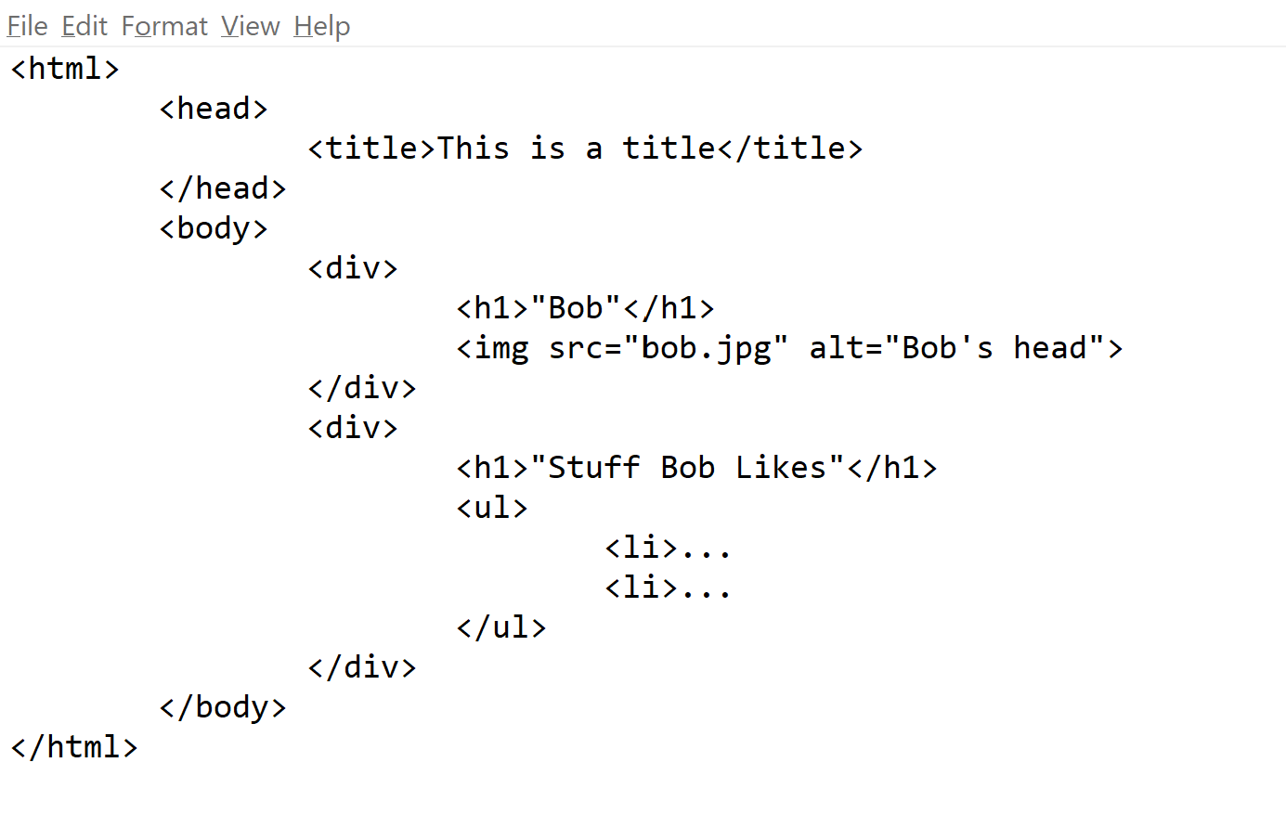

Slide 38
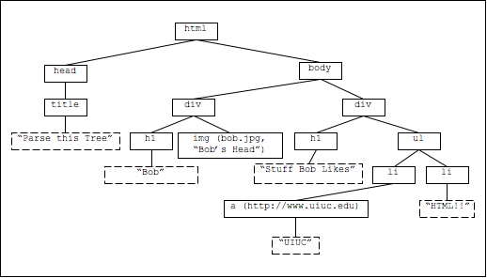
Website Structure
Notes:
Image source: http://ingbert.org/courses/webtech/lis390w1a_fall2009/quizzes/quiz2/quiz2.html

Slide 39
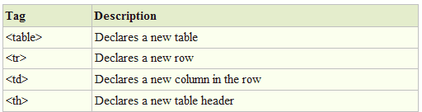
Tables in HTML

Slide 41
A Convenient Web Scraping Module: Beautiful Soup
Beautiful Soup is a Python package for parsing HTML and XML documents.
When you feed an HTML document into one of Beautiful Soup's parser classes, Beautiful Soup transforms the markup into a parse tree
  (a parse tree is a set of linked objects representing the structure of the document)
The parse tree can then be used to extract data from the HTML web page
  See documentation: https://www.crummy.com/software/BeautifulSoup/bs4/doc/

Slide 42
A Convenient Web Scraping Module: BeautifulSoup
To "scrape" a web site
  Open a connection to the web page
  Download the source (text) of the web page
  Convert the source to an HTML-aware BeautifulSoup object
  (Optional) Write the Beautiful Soup object to a file.
  Examine the contents of the Beautiful Soup object for HTML tags: <tag ...> ... </tag>
  Extract the tagged information you want from the BeautifulSoup

Slide 43
Scraping the Yield Curve
from urllib.request import urlopen # b_soup_1.py
from bs4 import BeautifulSoup
html = urlopen('https://www.treasury.gov/
resource-center/data-chart-center/interest-rates/
Pages/TextView.aspx?data=yieldYear&year=2019') # step 1
bsyc = BeautifulSoup(html.read(), "lxml") # steps 2 and 3
fout = open('bsyc_temp.txt', 'wt',
encoding='utf-8’)
fout.write(str(bsyc)) # save to file
fout.close()
Can provide other
parsers like
html.parser
Beautiful Soup
object
Notes:
The yield curve is a curve showing several yields or interest rates across different contract lengths for a similar debt contract. The curve shows the relation between the interest rate and the time to maturity, known as the "term", of the debt for a given borrower in a given currency

Slide 44
Example Beautiful Soup Functions
>>> bsyc.title # returns the first <title> tag
<title>
Daily Treasury Yield Curve Rates
</title>
>>> bsyc.title.string # returns the content of the first <title> tag
'\r\n\t\r\n\t Daily Treasury Yield Curve Rates \n \r\n\r\n’
>>> bsyc.title.parent.name # returns parent tag
'head'
>>> bsyc.find_all('title') # create list of all title tags

Slide 45
Scraping the Yield Curve (cont)
E.g. we want to get row for 08/01/19
Searching bsyc_temp.txt for 08/01/19, we are lucky to only find it once
    <td class="text_view_data" scope="row">08/01/19</td>
The tag is td
  Googling HTML td tells us this is a cell in a table
    <td> new column </td>
  Searching backward for <table, we find
    <table class="t-chart" xmlns:a....
  Let’s try to extract the entire table

Slide 46
Scraping the Yield Curve (cont)
# b_soup_1.py (cont)
# print the first table
print(str(bsyc.table))
# ... not the one we want
# so get a list of all table tags
table_list = bsyc.findAll('table')
# how many are there?
# remember, table_list is a list object
print('there are', len(table_list), 'table tags')

Slide 47
Scraping the Yield Curve (cont)
# b_soup_1.py (cont)
# look at the first 50 chars of each table
for t in table_list:
print(str(t)[:50])
# only one class="t-chart" table, so add that
# to findAll as a dictionary attribute
tc_table_list = bsyc.findAll('table', { "class" : "t-chart" } )
# findAll('table', 't-chart') will also work
# how many are there?
print(len(tc_table_list), 't-chart tables')
Notes:
https://www.crummy.com/software/Beautif
Signature: find_all(name, attrs, recursive, string, limit, **kwargs)ulSoup/bs4/doc/#find-all

Slide 48
Scraping the Yield Curve (cont)
# b_soup_1.py (cont)
# only 1 t-chart table, so grab it
tc_table = tc_table_list[0]
# what are this table's components/children?
for c in tc_table.children:
print(str(c)[:50])
# tag <tr> means table row, containing table data
# what are the children of those rows?
for c in tc_table.children:
for r in c.children:
print(str(r)[:50])

Slide 49
Scraping the Yield Curve (cont)
# b_soup_1.py (cont)
# we have found the table data!
# just get the contents of each cell
for c in tc_table.children:
for r in c.children:
print(r.contents)
# the contents of each cell is a list of one
# string -- we can work with those!
Notes:
https://www.crummy.com/software/BeautifulSoup/bs4/doc/#contents-and-children

